Slide 1
Monty Matlab Project SS 2021
Group 4
Jiangnan Huang, Zhouyi Gu, Zhiyuan Wu, Guang Chai
11.07.2021

Slide 2
Motivation to this project
It’s Part of Human Activity Recognition (HAR)
What’s Human Activity Recognition?
analyze human activities by observing and interpreting ongoing events
Why do we study HAR?
empower many real-world applications, such as visual surveillance, human-robot interaction,

Slide 3
Workflow and Contribution
Data Collection and Selection: all
Data Extraction: Jiangnan and Zhouyi
Model Training and Test: Guang and Zhiyuan
GUI: Jiangnan and Zhouyi
Optimization, Documentation and Presentation: all
Notes:
We record data and then discrad the very first and the very last part where we put the phone into pocket or take out the phone
generate many smaller data files from big and long walking data files. the generated data files have the same standard length.

Slide 4
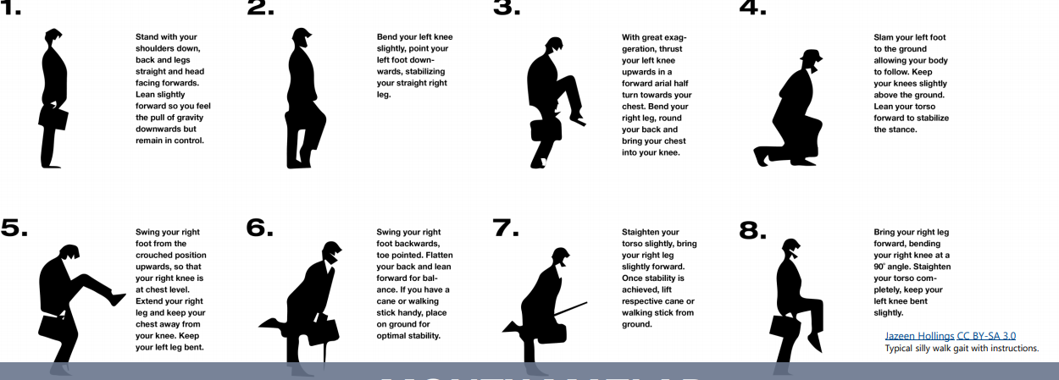
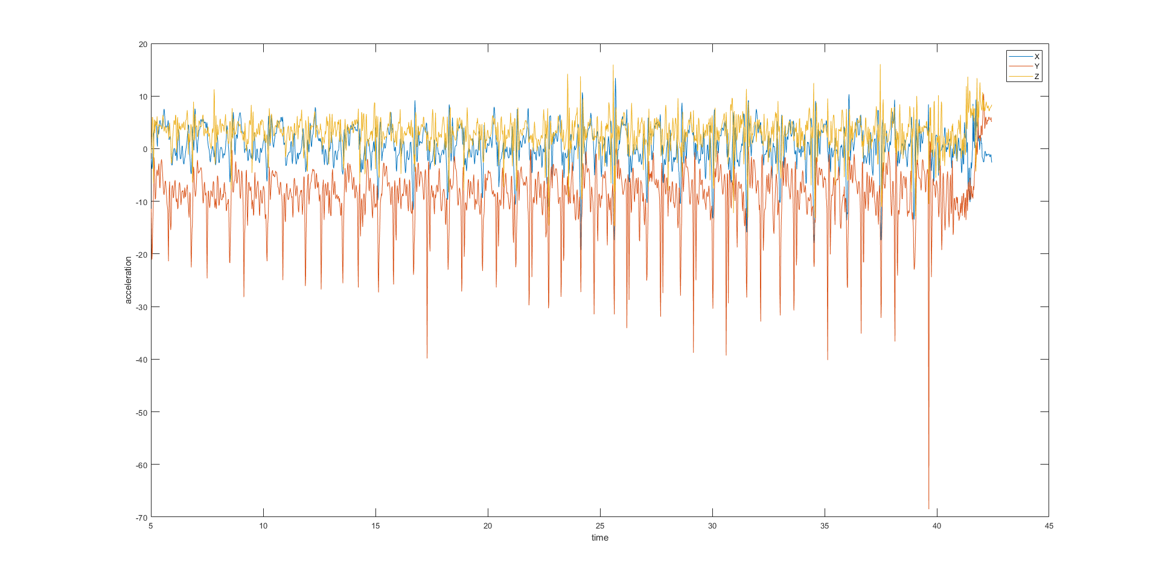
Data
Collection
Selection
Auto-labeling
normal walk, Group4_Walk<i>_N.mat
silly walk, Group4_Walk<i>_S.mat
source: MMLProjectKickOff2021.pdf
Notes:
in this section I would like to talk about data generation. we first activate acceleration sensor of matlab app and put smartphone in back pocket. then we start walking, normal or silly. here I give an example from script of silly walk. But in practice, we use our creativity to walk with random silly gesture and collect much data. this random silly walk can also enhance the robustness of our program later. after that we have to do some simple preprocessing, to select useful part of raw data. because we spend some time to do something with our smartphones and did not walk actually. so we delete first 10s for example to enhance robustness of our model. the raw data is saved in timetable. so we convert it, tranpose it, and add variable time as instruction. we manually do this data preprocessing or use script to do with auto labeling, normal or silly, and save data in mat files in this manner. here I present an example of silly walk. as you can see, the data Y changes heavily, which indicates silly movement.

Slide 5
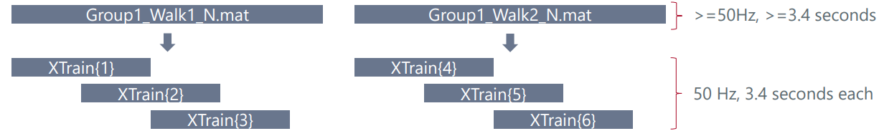
Data
Extraction: function [X,Y]=extractData(matFileContent,filename,samplingRateHz,windowWidthSeconds)
source: MMLProjectKickOff2021.pdf
Notes:
next step is data extraction. this function can resample data from mat file with default interpolation settings and slice interpolated data into small groups. the slices will be saved in cell and ready to be used as the input of our model. except that we add label for training depending on the name of mat file. for example, if the file ends with N.mat, it is normal walk. a highlight in this function is that it checks before slicing some correctness of given parameters, such as path correctness. both message on command window and a generated log file could be useful for debugging and anomaly detection. we use about 20% data after slicing for test and the rest for training.

Slide 6
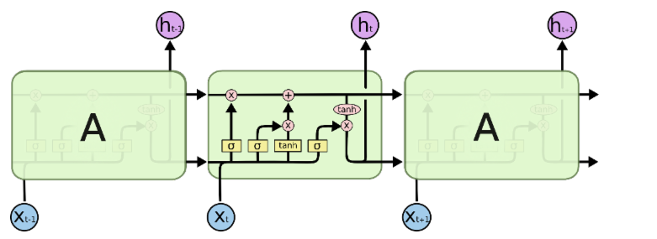
Model
LSTM
●Model with memory for time-series data
●Can learn very long-term dependencies
Training
Batch size: 32
Learning rate: 0.001
Epoch: 15
LSTM(100 Hidden Units)
Dropout layer +ReLU layer
Fully connected layer + Softmax layer
Classification layer
Notes:
A Long-Short Term Memory (LSTM) is an improved RNN. It is more complex, but easier to train, avoiding the vanishing gradient problem. LSTM networks can learn very long-term dependencies, which makes them well suited to model temporal dynamics in activity time-series. it retain important data from the previous inputs and use that information to modify the current output. it has internal units called gates that can regulate the flow of information. There’re three gates in LSTM unit: input gate, output gate and forget gate. These gates can learn which data in a sequence is important to keep or throw away. By doing that, it can pass relevant information down the long chain of sequences to make predictions. In our project, considering that our dataset is relative small, so we use only one LSTM layer with 100 hidden units. About 80% data are used for training and the rest 20%of data are used for test.The batch size is set 32, and lr is 0.001. We train 15 epochs.

Slide 7
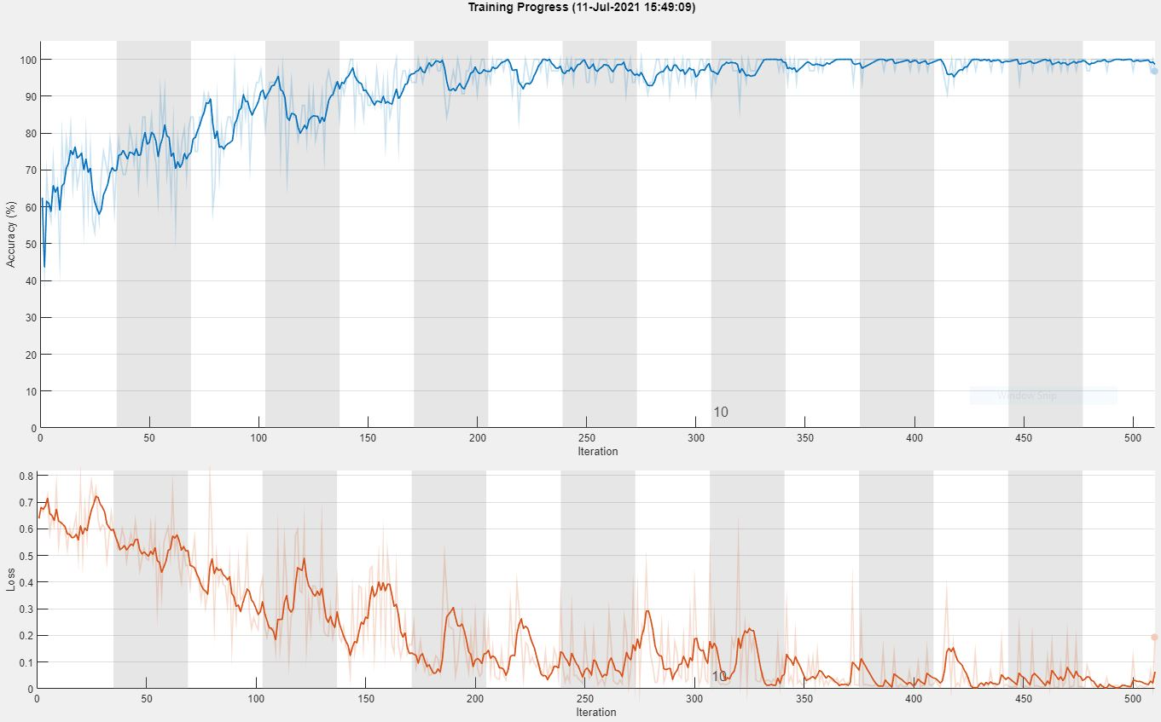
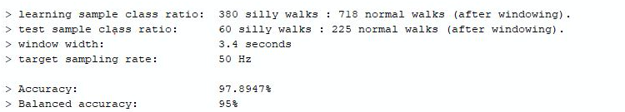
Result
Uni Test1:
Uni Test2:
3. Our own test on test data: Test accuracy 97%:
Notes:
Our code can successfully pass the Uni Test1 and Uni Test2. As the left figure shows, both accuracy and balanced accuracy are over 90%. The right figure shows how the training accuracy and training loss change during the training. Our result shows, that our model can fit our dataset very well. However, there’s much to be discussed. Our model can perform very well on our dataset, but our data is limited and can be biased. For further improvement, We can collect more data to cover people of different ages and different walking style.

Slide 8
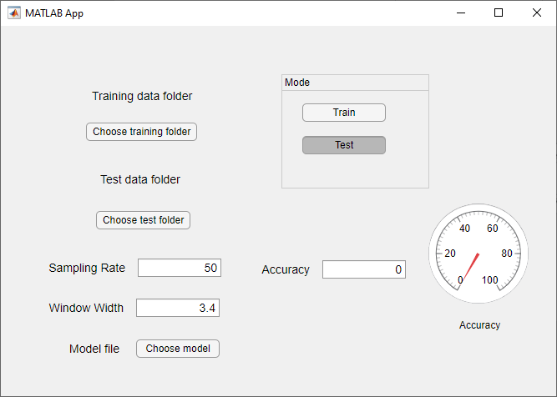
Graphical User Interface
Specify data folder with help of pop-up menu
Modify default value of Sampling Rate and Window Width
Train and display test accuracy in few clicks
Load and test other model with simply choosing test folder, model file and clicking test button
Notes:
We developed an GUI for interactively calling functions and displaying result. User can specify training data and test data folder in an pop-up menu by clicking corresponding button. If user do not specify any folder, the training and test data folder are defined as "TrainingData" and "TestData" in current folder by default respectively. Besides user can modify the default value of samplingRate and windowWidth with any positive number. After clicking the "train" button the training process is displayed in another pop-up menu and model will be automatically generated. With clicking "test" button the test accuracy will be displayed in short time. With help of model choosing button user is able to test other model on test set as well.

Slide 9

Demonstration

